Slide 1
Arduino
J.Owusu

Slide 2
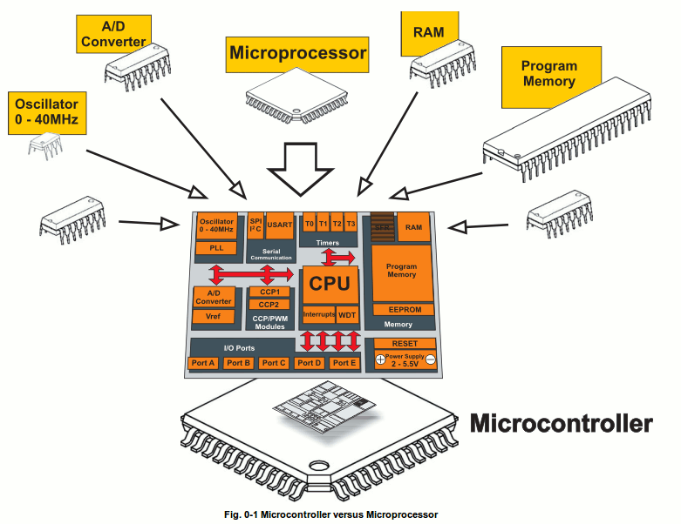
Topics:
Microcontrollers
Programming Basics: structure and variables
Digital Output
Analog to Digital Conversion
www.mikroe.com/chapters/view/1

Slide 3
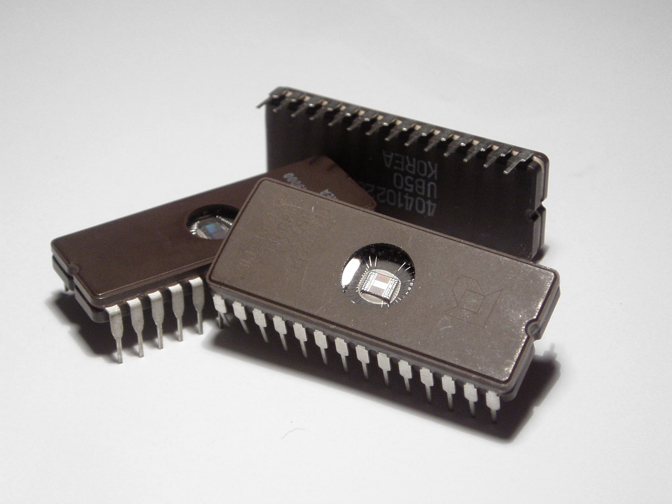
An integrated circuit (IC)
It is a set of electronic circuits on one small flat piece ("chip") of semiconductor material, normally silicon.
The integration of large numbers of tiny transistors into a small chip results in circuits that are orders of magnitude smaller, cheaper, and faster than those constructed of discrete electronic components.
The IC's mass production capability, reliability and building-block approach to circuit design has ensured the rapid adoption of standardized ICs in place of designs using discrete transistors.
ICs are now used in virtually all electronic equipment and have revolutionized the world of electronics.
The size, speed, and capacity of chips have progressed enormously. A modern chip may have many billions of transistors in an area the size of a human fingernail.
The main disadvantage of ICs is the high cost to design them and fabricate the required photomasks. This high initial cost means ICs are only practical when high production volumes are anticipated.
(EPROM) IC.

Slide 4
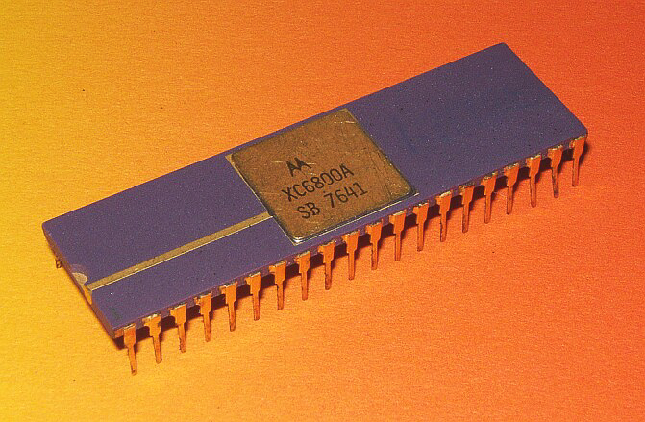
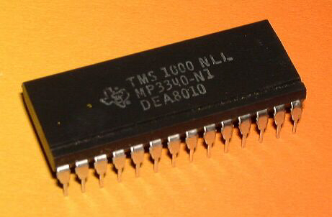
Microprocessor
It is a computer processor that incorporates the functions of a central processing unit on a single IC, or at most a few integrated circuits.
The microprocessor is a multipurpose, clock driven, register based, digital IC that accepts binary data as input, processes it according to instructions stored in its memory, and provides results as output. Microprocessors contain both combinational logic and sequential digital logic.
The integration of a whole CPU onto a single chip or on a few chips greatly reduced the cost of processing power, increasing efficiency.
Single-chip processors increase reliability because there are many fewer electrical connections that could fail.
Motorola
microcontroller
Texas
Instrumental
microprocessor

Slide 5
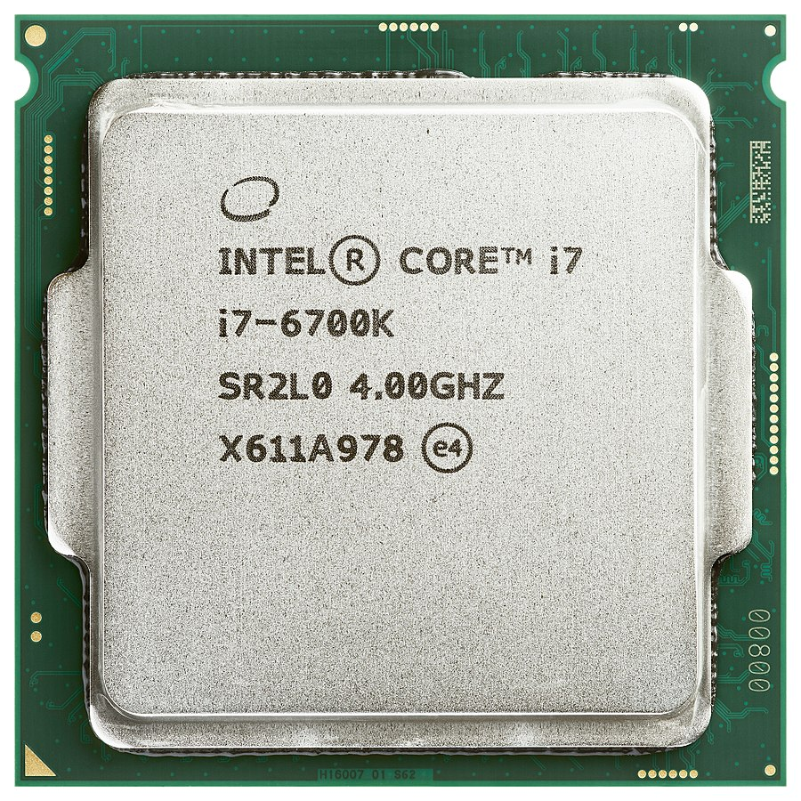
Processor
Frequently used to refer to the central processing unit, CPU is an electronic circuit which performs operations on some external data source, normally from memory or from some other data stream.
CPU contains at least a control unit (CU), arithmetic logic unit (ALU) and processor registers.

Slide 6
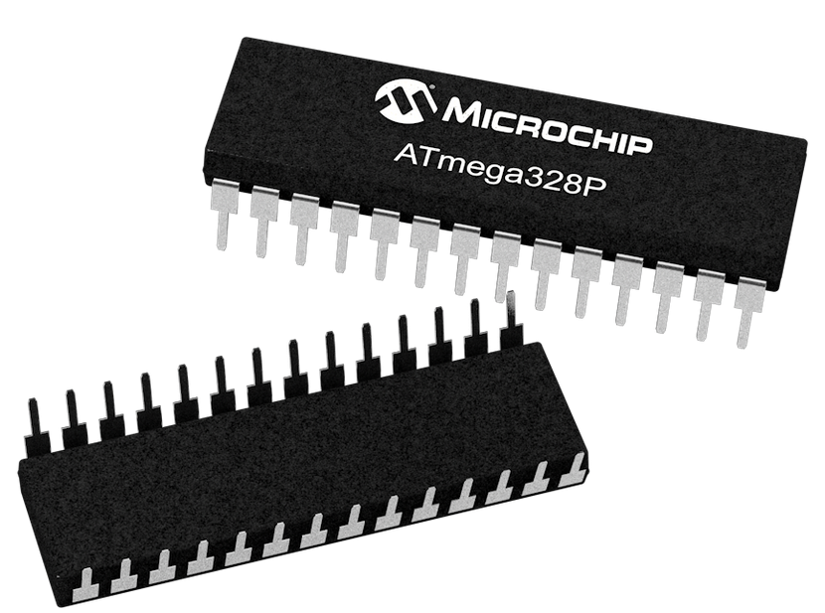
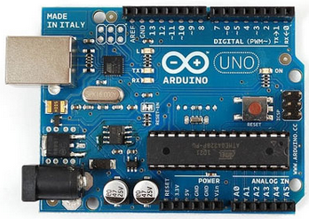
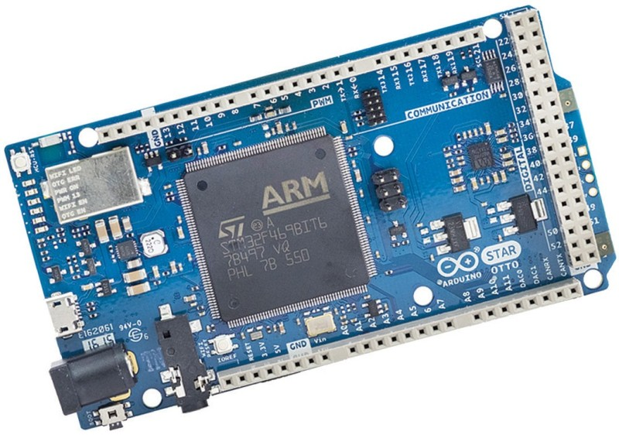
Microcontroller
A microcontroller is a processing system on small on a single IC. Is a lesser complexity compared to system on chip.
A microcontroller contains;
one or more processors (processing cores)
memory and
programmable input/output devices.
Program memory in the form of ROM is also often included on chip, as well as a small amount of RAM.
There maybe other element on the controller such as ADC, Pins, power supply.

Slide 7
System on Chip (SoC)
It is an IC that combines all components of a computer or other electronic system. SoC typically include CPU, memory, input/output ports and secondary storage – all on a single substrate.
It may contain signal processing functionalities
SoCs consume much less power and take up much less area than multi-chip designs with equivalent functionality. Because of this, SoCs are very common in the mobile computing.
Systems on chip are commonly used in embedded systems and the Internet of Things.

Slide 8
Systems-on-Chip can be viewed as part of a larger trend towards embedded computing
An SoC integrates a microcontroller or microprocessor with advanced peripherals like graphics processing unit (GPU), Wi-Fi module, or one or more coprocessors.
Similar to how a microcontroller integrates a microprocessor with peripheral circuits and memory,
Notes:
SoCs are in contrast to the common traditional motherboard-based PC architecture, which separates components based on function and connects them through a central interfacing circuit board.

Slide 9
Why Microcontrollers (Over Microprocessors)
Microcontrollers are designed for embedded applications, in contrast to the microprocessors used in personal computers or other general purpose applications consisting of various discrete chips.
A microcontroller turns to be small and low cost because of their simpler processors while microprocessors tend to be more expensive, very complicated and high tech manufacturing processes,
Microprocessors have very fast processor speeds ( i.e. 2Ghz, 3Ghz) while Microcontrollers are relatively slow processor speeds.
Microprocessors have many parts which include memory (RAM) and storage space while Microcontrollers have few and work as a stand alone device where everything is typically built into it.
Microprocessors have relatively high energy use, while Microcontrollers are very low energy use.

Slide 10
What is a Development Board
A printed circuit board designed to facilitate work with a particular microcontroller.
Typical components include:
  power circuit
  programming interface
  basic input; usually buttons and LEDs
  I/O pins

Slide 11
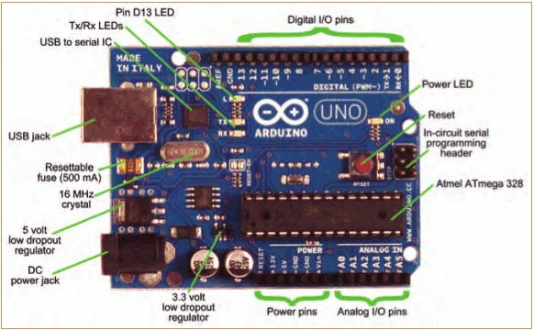
The Arduino Development Board
Making-robots-with-arduino.pdf

Slide 12
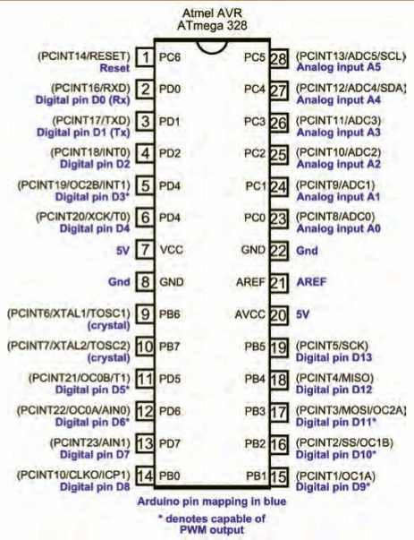
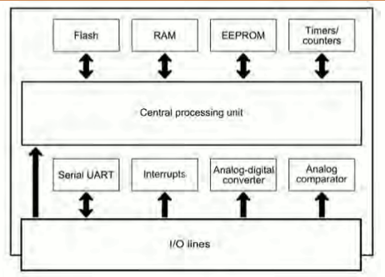
The Arduino Microcontroller: Atmel ARV Atmega 328
Specification
Making-robots-with-arduino.pdf

Slide 13
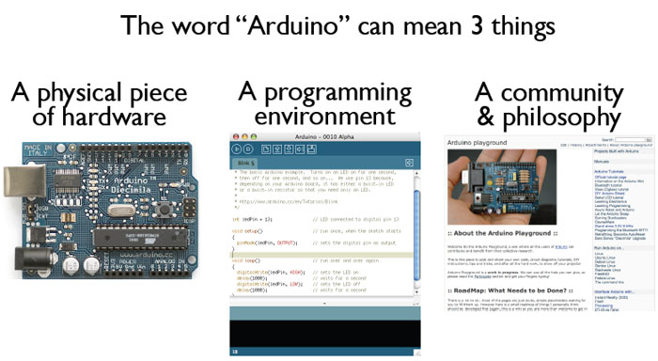
What is the Arduino
todbot.com/blog/bionicarduino

Slide 14
Getting Started
Check out: http://arduino.cc/en/Guide/HomePage
  Download & install the Arduino environment (IDE)
  Connect the board to your computer via the UBS cable
  If needed, install the drivers
  Launch the Arduino IDE
  Select your board
  Select your serial port
  Open the blink example
  Upload the program

Slide 15
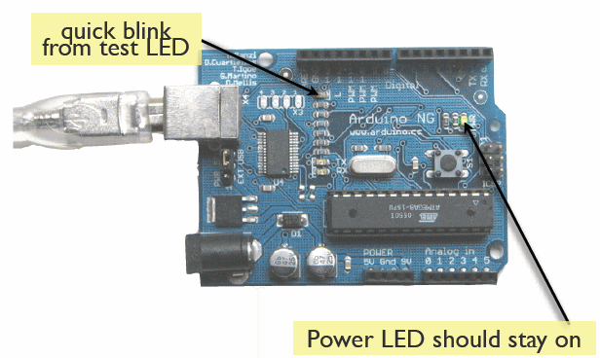
Try It: Connect the USB Cable
todbot.com/blog/bionicarduino

Slide 16
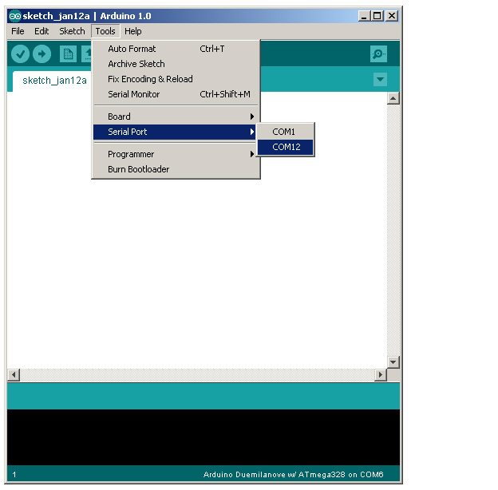
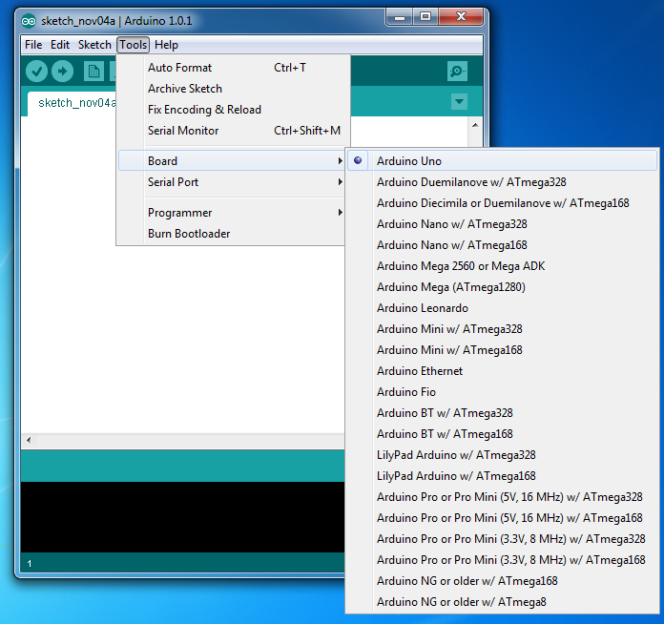
Arduino IDE
Select Serial Port and Board

Slide 17
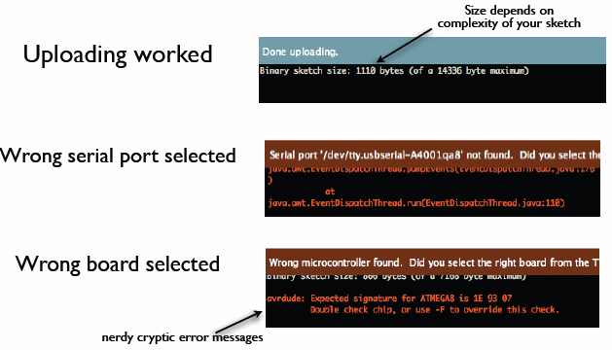
Status Messages
todbot.com/blog/bionicarduino

Slide 18
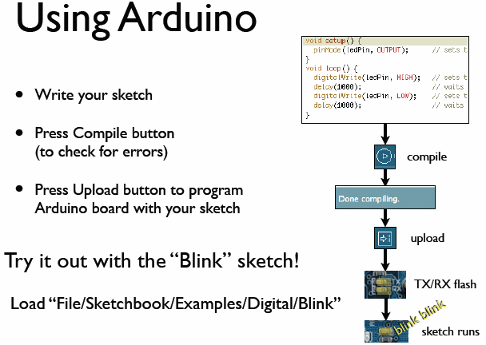
todbot.com/blog/bionicarduino

Slide 19
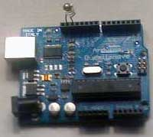
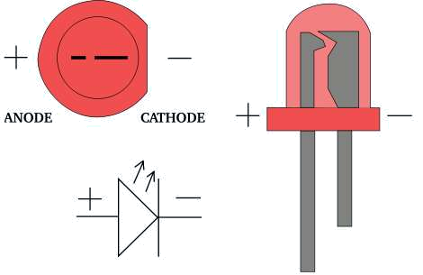
Add an External LED to pin 13
File > Examples > Digital > Blink
LED’s have polarity
  Negative indicated by flat side of the housing and a short leg
www.instructables.com

Slide 20
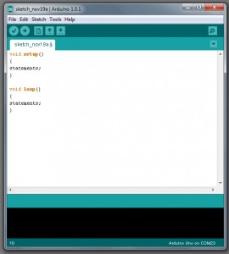
A Little Bit About Programming
Code is case sensitive
Statements are commands and must end with a semi-colon
Comments follow a // or begin with /* and end with */

Slide 21
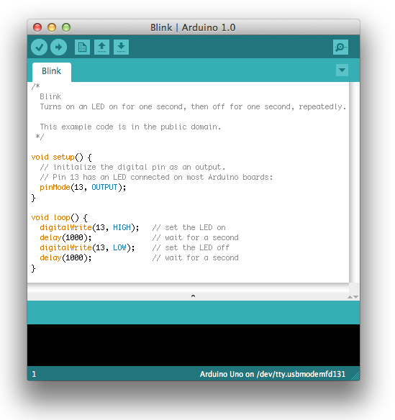
Our First Program

Slide 22
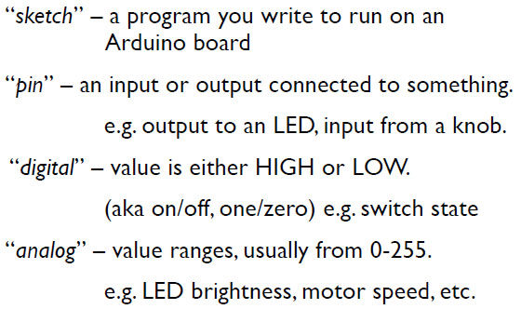
Terminology

Slide 23
Starting
void setup() {
// put your setup code here, to run once:
}
setup : It is called only when the Arduino is powered on or reset. It is used to initialize variables and pin modes
void loop() {
// put your main code here, to run repeatedly:
}
loop : The loop functions runs continuously till the device is powered off. The main code goes here.

Slide 24
Input/ Output
A pin on arduino can be set as input or output by using pinMode function.
pinMode(pin, mode)
  Sets pin to either INPUT or OUTPUT
  pin is pin number or variable holding pin
pinMode(13, OUTPUT); // sets pin 13 as output pin
pinMode(13, INPUT); // sets pin 13 as input pin

Slide 25
Reading/writing digital values
digitalRead(pin)
  Reads HIGH or LOW from a pin
digitalWrite(pin, value)
  Writes HIGH or LOW to a pin
digitalWrite(13, LOW); // Makes the output voltage on pin 13 , 0V
digitalWrite(13, HIGH); // Makes the output voltage on pin 13 , 5V
int buttonState = digitalRead(2); // reads the value of pin 2 in buttonState

Slide 26
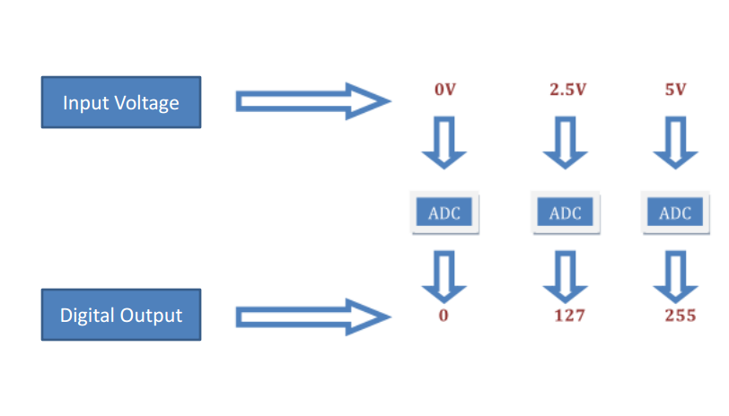
Analog to Digital Conversion
What is analog and why convert to digital ?
It is continuous range of voltage values
The microcontroller only understands digital data.

Slide 27
ADC in Arduino
The Arduino Uno board contains 6 pins for ADC
10-bit analog to digital converter
This means that it will map input voltages between 0 and 5 volts into integer values between 0 and 1023

Slide 28
Analog I/0
analogRead(pin)
  Reads analog value from 0 to 255 (8bits ADC)
analogRead(A0); // used to read the analog value from the pin A0
analogWrite(pin, value)
  Writes 0 to 255 to pin
analogWrite(2,128);

Slide 29
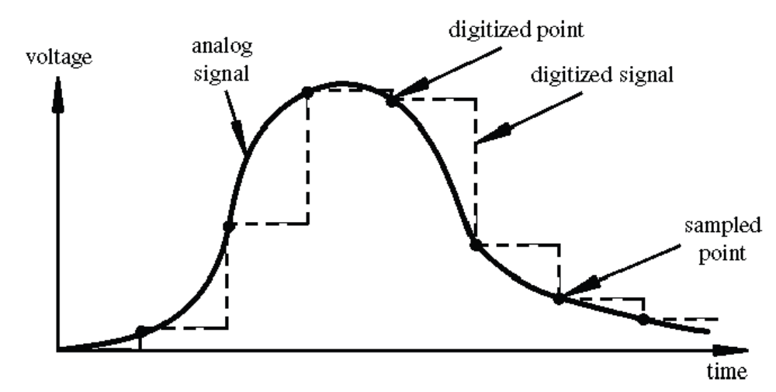
Digital? Analog?
Digital has two values: on and off
Analog has many (infinite) values
Computers don’t really do analog, they quantize
Remember the 6 analog input pins---here’s how they work
todbot.com/blog/bionicarduino

Slide 30
Arduino Timing
delay(ms)
  Pauses for a few milliseconds
delayMicroseconds(us)
  Pauses for a few microseconds
More commands: arduino.cc/en/Reference/HomePage

Slide 31
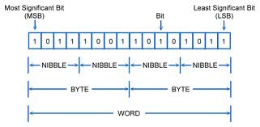
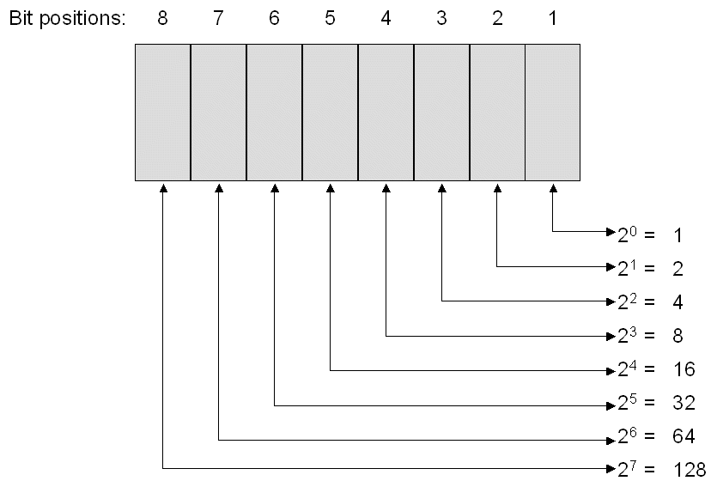
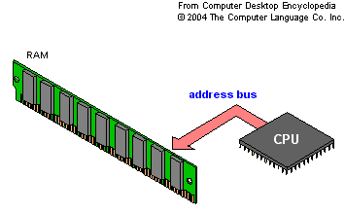
Bits and Bytes

Slide 32
Variable
Variables are used to store or hold values
Types
Int // stores integers
Syntax: int name value;
Example: int sum 1;
2. Double // stores floating point numbers
Syntax: double name value;
Example: double sum 1;
3. String // stores texts
Syntax: string name text;
Example: string sum answer is;

Slide 33
Conditions
To make decisions in Arduino code we use an ‘if’ statement
‘If’ statements are based on a TRUE or FALSE question
GREATER THAN a > b
LESS a < b
EQUAL a == b
GREATER THAN OR EQUAL a >= b
LESS THAN OR EQUAL a <= b
NOT EQUAL a != b
if( “answer is true”)
{
“perform some action”
}
else{
“perform some other action”}
if(true)
{
“perform some action”
}

Slide 34
Example
int counter = 0;
void setup() {
  Serial.begin(9600);
}
void loop() {
  if(counter < 10)
  {
      Serial.println(“less than 10”);
  }
  else
  {
      Serial.println(“greater than or equal to 10”);
      Serial.end();
  }
  counter = counter + 1;
int counter = 0;
void setup() {
  Serial.begin(9600);
}
void loop() {
  if(counter < 10)
  {
      Serial.println(counter);
  }
  counter = counter + 1;
}

Slide 35
BOOLEAN OPERATORS
If we want all of the conditions to be true we need to use ‘AND’ logic (AND gate)
We use the symbols &&
if ( val > 10 && val < 20)
If we want either of the conditions to be true we need to use ‘OR’ logic (OR gate)
We use the symbols ||
if ( val < 10 || val > 20)

Slide 36
Serial Transmission
Transferring data from the computer to an Arduino is done using Serial Transmission
To setup Serial communication we use the following
void setup() {
Serial.begin(9600);
}
void setup() {
Serial.begin(9600);
Serial.println(“Hello World!”);
}
void loop() {}

Slide 37
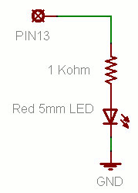
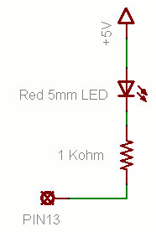
Putting It Together
Complete the sketch (program) below.
What output will be generated by this program?
What if the schematic were changed? ➔
Write the sketch for this circuit to cause an external LED to blink with 2 minutes delay.

Slide 38
Comment these lines of code
// the setup function runs once when you press reset or power the board
void setup() {
pinMode(LED_BUILTIN, OUTPUT);
}
void loop() {
digitalWrite(LED_BUILTIN, HIGH);
delay(1000);
digitalWrite(LED_BUILTIN, LOW);
delay(1000);

Slide 39
Example 2: using push button to control LED
// constants won't change. They're used here to set pin numbers:
const int buttonPin = 2; // the number of the pushbutton pin
const int ledPin = 13; // the number of the LED pin
// variables will change:
int buttonState = 0; // variable for reading the pushbutton status
void setup() {
// initialize the LED pin as an output:
pinMode(ledPin, OUTPUT);
// initialize the pushbutton pin as an input:
pinMode(buttonPin, INPUT);
}

Slide 40
void loop() {
// read the state of the pushbutton value:
buttonState = digitalRead(buttonPin);
// check if the pushbutton is pressed. If it is, the buttonState is HIGH:
if (buttonState == HIGH) {
// turn LED on:
digitalWrite(ledPin, HIGH);
} else {
// turn LED off:
digitalWrite(ledPin, LOW);
}
}

Slide 41
Read analog value
// These constants won't change. They're used to give names to the pins used:
const int analogInPin = A0; // Analog input pin that the potentiometer is attached to
const int analogOutPin = 9; // Analog output pin that the LED is attached to
int sensorValue = 0; // value read from the pot
int outputValue = 0; // value output to the PWM (analog out)
void setup() {
// initialize serial communications at 9600 bps:
Serial.begin(9600);
}

Slide 42
void loop() {
// read the analog in value:
sensorValue = analogRead(analogInPin);
// map it to the range of the analog out:
outputValue = map(sensorValue, 0, 1023, 0, 255);
// change the analog out value:
analogWrite(analogOutPin, outputValue);
// print the results to the Serial Monitor:
Serial.print("sensor = ");
Serial.print(sensorValue);
Serial.print("\t output = ");
Serial.println(outputValue);
// wait 2 milliseconds before the next loop for the analog-to-digital
// converter to settle after the last reading:
delay(2);
}

Slide 43
Using Analog input as control
int sensorPin = A0; // select the input pin for the potentiometer
int ledPin = 13; // select the pin for the LED
int sensorValue = 0; // variable to store the value coming from the sensor
void setup() {
// declare the ledPin as an OUTPUT:
pinMode(ledPin, OUTPUT);
}
void loop() {
// read the value from the sensor:
sensorValue = analogRead(sensorPin);
// turn the ledPin on
digitalWrite(ledPin, HIGH);
// stop the program for <sensorValue> milliseconds:
delay(sensorValue);
// turn the ledPin off:
digitalWrite(ledPin, LOW);
// stop the program for for <sensorValue> milliseconds:
delay(sensorValue);

Slide 44
const int lowestPin = 2;
const int highestPin = 13;
void setup() {
// set pins 2 through 13 as outputs:
for (int thisPin = lowestPin; thisPin <= highestPin; thisPin++) {
pinMode(thisPin, OUTPUT);
}
}

Slide 45
void loop() {
// iterate over the pins:
for (int thisPin = lowestPin; thisPin <= highestPin; thisPin++) {
// fade the LED on thisPin from off to brightest:
for (int brightness = 0; brightness < 255; brightness++) {
analogWrite(thisPin, brightness);
delay(2);
}
// fade the LED on thisPin from brightest to off:
for (int brightness = 255; brightness >= 0; brightness--) {
analogWrite(thisPin, brightness);
delay(2);
}
// pause between LEDs:
delay(100);
}
}

Slide 46
PART 2

Slide 47
Example :Using Potentiometer as Analog sensor to vary analog voltage input which is used to control intensity of light
const int analogPin1 = A0;
const int LedPin1 = 10;
int sensorValue = 0;
int sensorLevel = 0;
void setup() {
Serial.begin(9600);
pinMode(analogPin1, INPUT);
pinMode(LedPin1, OUTPUT);
}
void loop() {
sensorValue = analogRead(analogPin1);
Serial.println("sensor Value is :\t");
Serial.println(sensorValue);
Serial.println("\n");
sensorLevel = map(sensorValue,0,1023,0,225);
Serial.println("sensor level level is :\t");
Serial.println(sensorLevel);
Serial.println("\n");
analogWrite(LedPin1,sensorLevel);
analogWrite(12,sensorLevel);
analogWrite(9,sensorLevel);
}

Slide 48
Sensor Calibration
In order to achieve maximum and minimum values of the sensor readings, the initial transient stage is allow to settle into steady state (first five seconds of the sketch execution define the minimum and maximum of expected values attached to the sensor pin).
The sensor minimum and maximum initial values may seem backwards. Initially, you set the minimum high and listen for anything lower, saving it as the new minimum. Likewise, you set the maximum low and listen for anything higher as the new maximum.
The circuit:
Input - analog sensor (potentiometer will do) attached to analog input 0
output - LED attached from digital pin 9 to ground

Slide 49
Callibration
// These constants won't change:
const int sensorPin = A0; // pin that the sensor is attached to
const int ledPin = 9; // pin that the LED is attached to
// variables:
int sensorValue = 0; // the sensor value
int sensorMin = 1023; // minimum sensor value
int sensorMax = 0; // maximum sensor value

Slide 50
void setup() {
// turn on LED to signal the start of the calibration period:
pinMode(13, OUTPUT);
digitalWrite(13, HIGH);
// calibrate during the first five seconds
while (millis() < 5000) {
sensorValue = analogRead(sensorPin);
// record the maximum sensor value
if (sensorValue > sensorMax) {
sensorMax = sensorValue;
}
// record the minimum sensor value
if (sensorValue < sensorMin) {
sensorMin = sensorValue;
}
}

Slide 51
// signal the end of the calibration period
digitalWrite(13, LOW);
}
void loop() {
// read the sensor:
sensorValue = analogRead(sensorPin);
// apply the calibration to the sensor reading
sensorValue = map(sensorValue, sensorMin, sensorMax, 0, 255);
// in case the sensor value is outside the range seen during calibration
sensorValue = constrain(sensorValue, 0, 255);
// fade the LED using the calibrated value:
analogWrite(ledPin, sensorValue);
}

Slide 52
Arduino Functions
We consider how to write your own functions and use them in your sketches.
Uses of function
We use function to perform analysis or manipulation (Mathematics) on the analog or digital values we obtain from the ports or
Perform analysis on a variable or parameter that we can pass later to output to control (example speed of motor, arm of robot) or display on an output device such as the 16X2 LCD display (example display temperature value, or gas content, or volume).

Slide 53
Functions were briefly encountered in earlier section when we talk about void setup and void loop.
Some basic facts about functions;
1) each function must have a unique name,
2) the function name is followed by parentheses ()
3) functions have a return type, e.g. void,
4) the body of a function is enclosed in opening and closing braces {}.

Slide 54
The Structure of a Function
Before a function can be used in a sketch, it must be created.
The following code is an example of a function that was created to print a dashed line in the Arduino IDE.
void FuncName()
{
Serial.println(“simple function call FuncName that print on screen");
}
The code above that creates the simple function call FuncName that print on screen.

Slide 55
Function Name
When we create a function, it must be given a name. The naming convention for functions is the same as for variables:
The function name can be made up of alphanumeric characters (A to Z; a to z; 0 to 9) and the underscore (_).
The function name may not start with a number i.e. the numbers 0 to 9.
A function name must not be used that is the same as a language keyword or existing function.
The function name ends with parentheses (). Nothing is passed to the example function above, so the parentheses are empty. Passing values or parameters to functions is call function argument which the function body operate on.
Return Type
A function must have a return type. The example function does not return anything, so has a return type of void.
Function Body
The function body is made up of statements placed between braces {}. The statements make up the functionality of the function (what the function will do when it is called).
When a function is used, it is said to be "called".

Slide 56
Calling a Function
To use the function that was created above, it must be called in a sketch as shown in the sketch below.
void setup() {
Serial.begin(9600);
FuncName();
Serial.println("| Program Menu |");
FuncName();
}
void loop() {
}
void FuncName()
{
Serial.println("----------------");
}

Slide 57
Calling a Function
In the sketch above, the FuncName() function is created at the bottom of the file and then called twice at the top of the file as shown in the image below.
To call a function, use the function name followed by opening and closing parentheses. Finally terminate the statement that calls the function with a semicolon. Example: FuncName();
Load the sketch to an Arduino and then open the terminal window. The sketch prints some text in a box as shown below.
The first time that the function is called, it prints the dashed line shown in the top of the image. Text is then written to the serial monitor window by the statement below the function call. The function is then called again to print the same dashed line that completes the box.

Slide 58
Why Use Functions
The function used in the example above is very simple, so all the benefits of using functions will not be seen immediately.
One advantage of using functions is that they avoid having to write the same code over and over again in a sketch which saves time and memory. Every time that a function is called, we are just reusing code that has been written once.
If a function needs to be modified, it only has to be done once and the modifications will take effect every place in a sketch that the function is called. If a function was not used, each place that the statements are found in a sketch to do a particular task would need to be located and modified.
Functions can be used to break a sketch up into pieces which make it more modular and easier to understand.
Functions can be reused in other sketches.

Slide 59
Passing a Value to a Function
In the sketch above, the length of the line that the function prints out is fixed in the function. If we change the text that is in the box, it may not fit in the box properly. The function needs to be modified so that we can tell it what size line it must draw.
The above function can be modified to pass a value to it that will tell it how many characters long to make the line that it draws.

Slide 60
Passing a Value to a Function
The modified sketch is shown below.
void setup() {
Serial.begin(9600);
// draw the menu box
FuncName(24);
Serial.println("| Program Options Menu |");
FuncName(24);
}
void loop() {
}
void FuncName(int len)
{
int i;
// draw the line
for (i = 0; i < len; i++) {
Serial.print("-");
}
// move the cursor to the next line
Serial.println("");
}
The FuncName() function in the above sketch is modified so that an integer value can be passed to it. The line needs to be 24 characters long to fit the new menu text into it, so we pass it a value of 24.
FuncName(24); // passing a value of 24 to the function

Slide 61
The function needs to be able to accept an integer value that is passed to it. The variable type and the name of the variable are inserted between the opening an closing parentheses after the function name.
void FuncName(int len)
We can now use the len integer variable in the body of the FuncName() function. The variable will contain whatever value was passed to it when the function was called.
The body of the sketch uses the len variable in a for loop to print out the correct number of dashes that make up the dashed line of the menu box.
The cursor is moved to the next line in the serial monitor by calling Serial.println(""); with an empty string.
After the function has run the last statement in its body, it is said to "return". When a function returns, program execution continues below the statement that called the function – i.e. the statement below the function call is run next.

Slide 62
Example :Function to calculate Area
Int x= 0; // global variable to hold area in m
Int y= 0; // global variable to hold area in cm
void setup() {
Serial.begin(9600);
x= FuncArea(2, 4); // function call
// 2 and 4 are in meters
Serial.print(“The area in meters is: \t");
Serial.print(x);
Serial.println(“m”);
}
void loop() {
y = x *10000
Serial.print(“area in centimeters is”);
Serial.print(y);
Serial.println(“cm”);
}
int FuncArea(int length, int height)
//function declaration and definition
{
int Area = length * height;
Serial.print(“The area from function is: \t");
Serial.println(Area);
return Area;
}

Slide 63
Example: Function to calculate temperature value obtain in form of voltage from A0 (ADC) and display on LCD
Connect LCD to Arduino UNO:
Connect the VCC and GND terminal on the LCD to the +5V and GND on Arduino respectively
Connect the SDA from the UART to the SDA on the Arduino (A4)
Connect the SCL from the UART to the SCL on the Arduino (A5)
Download the Liquid Crystal Library if you don’t have it.
Load the libraries (select sketch and go to include library and choose the zip file)
#include wires.h
#include LCD.h
#include LiquidCrystal_12C.h

Slide 64
Sample LCD display:Hello World
#include wires.h
#include LiquidCrystal_12C.h
//LiquidCrystal_12C lcdDisplay(0x27, 2,1,0,4,5,6,7,3,POSITIVE);
LiquidCrystal_12C lcd (0x27, 20,4);
void setup() {
Serial.begin(9600);
lcd.init(); // initialize the lcd
lcd.init();
lcd.backlight();
lcd.setCursor(3,0);
lcd.print("Hello, world!");
//lcdDisplay.begin(16,2);
lcd.clear();
lcd.print(“Hello World”);
Serial.println(“Hello World”);
}
void loop()
{
lcd.setCursor(1,1);
lcd.print(" Keep flashing");
Serial.println(“Keep flashing”);
}

Slide 65
If you're using a 5V Arduino, and connecting the sensor directly into an Analog pin, you can use these formulas to turn the 10-bit analog reading into a temperature:
Voltage at pin in milliVolts = (reading from ADC) * (5000/1024)
This formula converts the number 0-1023 from the ADC into 0-5000mV (= 5V)
If you're using a 3.3V Arduino, you'll want to use this:
Voltage at pin in milliVolts = (reading from ADC) * (3300/1024)
This formula converts the number 0-1023 from the ADC into 0-3300mV (= 3.3V)
Then, to convert millivolts into temperature, use this formula:
Centigrade temperature = [(analog voltage in mV) - 500] / 10

Slide 66
Calculate temperature value obtain in form of voltage from A0 (ADC) and display on LCD
//Example Using TMP36 sensor with the resolution of 10 mV / degree //centigrade with a 500 mV offset to allow for negative temperatures
int sensorPin = 0; //the analog pin the TMP36's Vout (sense) pin is connected to
#include wires.h
#include LCD.h
#include LiquidCrystal_12C.h
LiquidCrystal_12C lcdDisplay(0x27, 2,1,0,4,5,6,7,3,POSITIVE);
void setup() {
lcdDisplay.begin(16,2);
lcdDisplay.clear();
Serial.begin(9600); //Start the serial connection with the computer
//to view the result open the serial monitor
}

Slide 67
void loop() { // run over and over again
//getting the voltage reading from the temperature sensor
int reading = analogRead(sensorPin);
// converting that reading to voltage, 5V VCC
float voltage = reading * 5.0;
voltage /= 1024.0; // voltage = voltage/1024;
Serial.print(“ the voltage reading is : \t”); // now print out the voltage
lcdDisplay.print(“ volt reading is ”); // print on LCD
Serial.print(voltage); Serial.println(" volts"); // print out the voltage
Serial.print(“Temperature in degree C reading is : \t”); // now print out the temperature
float temperatureC = (voltage - 0.5) * 100 ; //converting from 10 mv per degree wit //500 mV offset to degrees ((voltage - 500mV) times 100)
Serial.print(temperatureC); Serial.println(" degrees C");
Serial.print(“ Temperature in degree F reading is : \t”); // now convert to Fahrenheit
float temperatureF = (temperatureC * 9.0 / 5.0) + 32.0;
Serial.print(temperatureF);
lcdDisplay.print(temperatureF);
Serial.println(" degrees F");
delay(1000); //waiting a second
}

Slide 68
Example: Function to calculate temperature value obtain in form of voltage from A0 (ADC) and display on LCD
#include wires.h
#include LiquidCrystal_12C.h
int VccValue = 5; // global variable holding VCC
int sensorPin = A0; // global variable to hold analog input
LiquidCrystal_12C lcdDisplay(0x27, 20,4);
void setup() {
Serial.begin(9600);
lcdDisplay.init(); // initialize the lcd
lcdDisplay.init();
lcdDisplay.backlight();
lcdDisplay.setCursor(3,0);
lcdDisplay.print(“Temperature is :"); lcdDisplay.setCursor(19,0);
lcdDisplay.print(“C");
lcdDisplay.setCursor(16,0); }

Slide 69
void loop() {
//getting the voltage reading from the temperature sensor
int readValue = analogRead(sensorPin);
TempC = FuncTempC(readValue); // Function call
// now print out the temperature in degrees celcious
Serial.print(“Temperature in degree C reading is : \t”);
Serial.print(tempC);
Serial.println(" degrees C");
lcdDisplay. print(tempC);
TempF = FuncTempF(readValue); //function call
// now print out the temperature in Felrinhat
Serial.print(“Temperature in degree F reading is : \t”);
Serial.print(tempF);
Serial.println(" degrees F");
lcdDisplay. print(tempF);
}

Slide 70
// Functions define here
// converting that reading to voltage, 5V VCC
int FuncTempC (readValues)
{
float voltageValue = readValues * VccValue)
voltage /= 1024.0; // voltage = voltage/1024;
// now print out the voltage
Serial.print(“ the voltage reading is : \t”);
Serial.print(voltage);
Serial.println(" volts"); // print out the voltage
float temperatureC = (voltage - 0.5) * 100 ; //converting from 10 mv per degree wit //500 mV offset to degrees ((voltage - 500mV) times 100)
return temperatureC;
}
int FuncTempF (readValues)
{
float voltageValue = readValues * VccValue)
voltage /= 1024.0; // voltage = voltage/1024;
// now print out the voltage
//Serial.print(“ the voltage reading is : \t”);
//Serial.print(voltage);
//Serial.println(" volts"); // print out the voltage
//converting from 10 mv per degree wit
//500 mV offset to degrees ((voltage - 500mV) times 100)
float temperatureC = (voltage - 0.5) * 100 ;
// now convert to Fahrenheit
float temperatureF = (temperatureC * 9.0 / 5.0) + 32.0;
return temperatureF;
}

Slide 71
Example: Function to read analog and condition the signal
Another example
This function will read a sensor five times with analogRead() and calculate the average of five readings. It then scales the data to 8 bits (0-255), and inverts it, returning the inverted result.
int ReadSens_and_Condition(){
int i;
int sval = 0;
for (i = 0; i < 5; i++){
sval = sval + analogRead(0); // sensor on analog pin 0
}
sval = sval / 5; // average
sval = sval / 4; // scale to 8 bits (0 - 255)
sval = 255 - sval; // invert output
return sval;
}
int sens;
sens = ReadSens_and_Condition(); // To call our function we just assign it to a variable.

Slide 72
Assignment : Arduino lab Assignment
Use Arduino to design a moisture sensor.
Display the voltage value on the first row LCD
and interpret it as dry, moist or wet soil on the third row.

